Slide 1


Python Basics with Selenium

Slide 2

Agenda
What is Python?
What is Selenium?
Why Selenium?
Why Selenium with Python?
Understanding Selenium components
Selenium WebDriver
WebDriver Manager for Python
Live Demo
Navigating
Locating Elements
Waits

Slide 3
What is Python?
Python is an interpreted, object-oriented, high-level programming language.
Python is a high level, interpreted programming language. Python uses simple English keywords, which is easy to interpret. It has less syntax complications than any other programming languages.
Guido van Rossum began working on Python in the late 1980s as a successor to the ABC programming language and first released it in 1991 as Python 0.9.0.

Slide 4
Uses of Python
web development (server-side),
software development,
Data Science,
Machine Learning
system scripting.
Scripting

Slide 5
What is Selenium?
Selenium is an open-source tool that automates web browsers.
Supports different programming languages like Java, Python, Ruby, Perl, C# and more.

Slide 6
Why Selenium?
The Perfect Framework That Does the Right Job
Open Source
Flexibility

Slide 7
Why Selenium with Python?
It requires far less code than other programming languages.
It has an English-like syntax that makes it human-readable. Also, it is easy to pick up and learn due to its less complex syntax.
Python is a free, open-source programming language with numerous libraries and frameworks.

Slide 8
Understanding Selenium Components?
Selenium IDE
Selenium Remote Control
RC does not interact with the browser directly. It has a server that acts as an HTTP proxy to control the browser remotely.
Selenium WebDriver
Selenium Grid
The main functionality of Selenium Grid is to run tests in parallel and to perform cross-platform testing.

Slide 9
Selenium WebDriver?
Interact with the browser directly.
Permits cross-browser and cross-platform automation.
Allows to choose programming language to create test scripts.

Slide 10
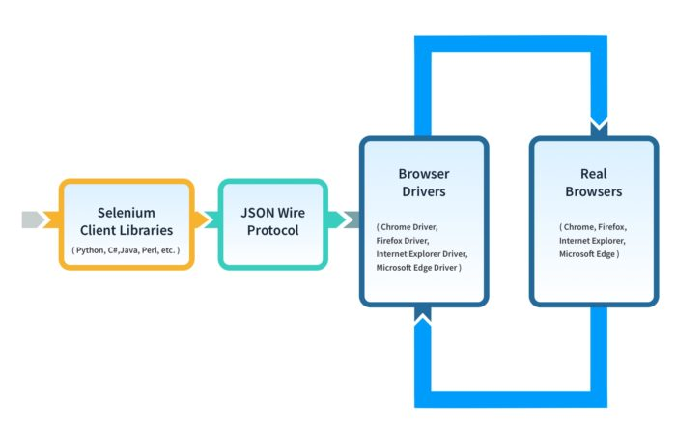
Selenium WebDriver Framework Architecture
WebDriver Architecture is
Made up with four major components:
Selenium Client library
JSON wire protocol over HTTP
Browser Drivers
Browsers

Slide 11
WebDriver Manager
The main idea is to simplify management of binary drivers for different browsers.
Steps:
Install manager
pip install webdriver-manager
2. Use with Browsers
webdriver.Chrome(service=ChromeService(ChromeDriverManager().install()))

Slide 12
Navigating
The first thing is to do with WebDriver is navigate to a link.
The normal way to do it is:
driver.get(“url”)

Slide 13
Locating Elements
There are various ways to locate the elements in a page.
find_element: to find a specific element
find_elements: to find multiple elements
from selenium.webdriver.common.by import By
Locator Strategies:
ID
XPATH
LINK_TEXT
PARTIAL_LINK_TEXT
NAME
TAG_NAME
CLASS_NAME
CSS_SELECTOR

Slide 14
WebDriver Waits
Selenium WebDriver provides two types of Waits:
Implicit Waits: Will wait for given amount of seconds even if object is visible in the DOM
Explicit Waits: Will wait until a certain condition is met

Slide 15
References
Python Tutorial:
https://www.w3schools.com/python/
https://www.youtube.com/watch?v=rfscVS0vtbw&t=41s
Selenium with Python
https://selenium-python.readthedocs.io/
https://pypi.org/
https://www.selenium.dev/documentation/
https://www.youtube.com/watch?v=86nEglbjvIk&list=PLFGoYjJG_fqq2l-8EuBTZJ3lLcOrCNaiH

Slide 16

Q&A

Slide 17
Thanks

